Slide 1

Urate induced epigenetic modifications:
Induction of Innate Memory by Urate?
Prof. dr. Leo A. B. Joosten
CAMBAC/INSIGHT CORT/G-CAN meeting
UAB, Birmingham, USA, June 6, 2019
¹Department of Internal Medicine, Radboud University Medical Center
Nijmegen, The Netherlands
²Department of Medical Genetics, University of Medicine and Pharmacy „Iuliu Hațieganu”,
Cluj-Napoca, Romania

Slide 2
  UAB, June 6, 2019
Disclosure of speaker’s interests
(Potential) conflict of interest | See below
Potentially relevant company relationships in connection with event
Sponsorship or research funding Fee or other (financial) payment Shareholder Other relationship, i.e. … | Radboudumc PhD grant, Reumafonds, Romania-EU grant, EFRO-Coiled grant, H2020-EU Reprogram, CVON In-Control grant, Ardea Biosciences, Novartis AG, SAB member Olatec Therapeutics Synmabtix BV, TRAINED Therapeutics None

Slide 3
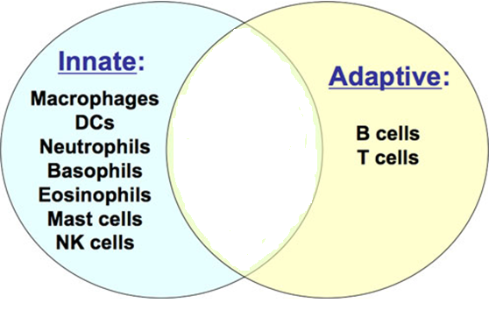
Innate versus specific immunity
Innate immunity:
Rapid
Effective
Not-specific, indiscriminate
Lacks immunological memory
Adaptive immunity:
Needs 10-14 days
A specific activation against a particular
Microorganism, enhancing the effectivity of the response
Builds immunological memory

Slide 4
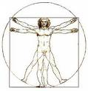

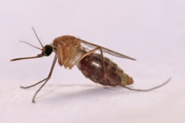
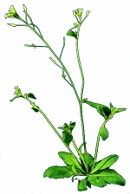
“Memory: the ability of a system to store and recall information on previously encountered characteristics “
Fishes
Amphi-
bians
Reptiles
Birds
Mammals
Holometa-bolous
Heterometa-bolous
Placoderms
5%
Innate and Adaptive
Gnathostomes
Insects
95%
Innate
-450 My
Agnathans
Molluscs
Echinoderms
Urochordates
Annelids
-800 My
Plants
-1 By

Slide 5
Systemic Acquired Resistance (SAR) in plants
Innate versus specific immunity

Slide 6
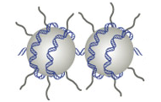
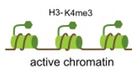
“Trained Immunity” or Innate Memory
Urate as first stimulus
Monocyte
Pro-inflammatory
cytokines
MSU, C16.0, ect. as second stimulus
Epigenetic reprogramming
me3
Ac
Trained
monocyte
me3
Pro-inflammatory
cytokines
Ac

Slide 7
Trained Immunity versus Tolerance Induction

Slide 8
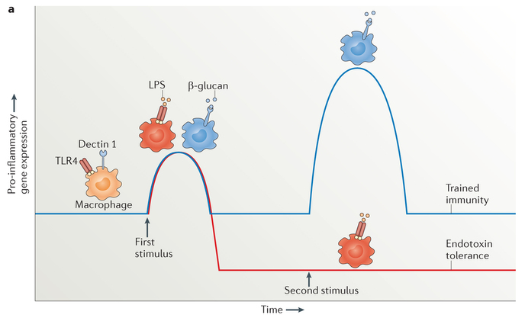
“Trained Immunity” or Innate Memory
Alvarez-Errico, Nat Rev Immunol 2015

Slide 9
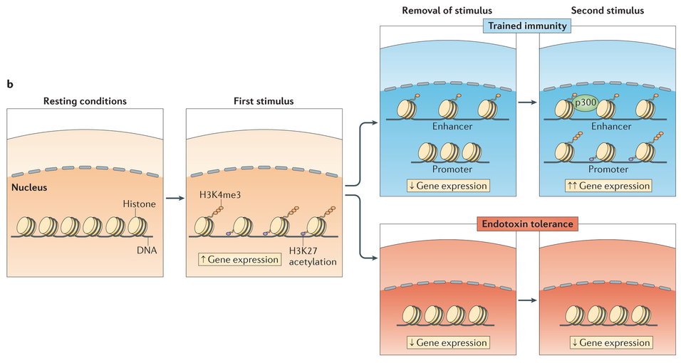
“Trained Immunity” or Innate Memory
Alvarez-Errico, Nat Rev Immunol 2015

Slide 10
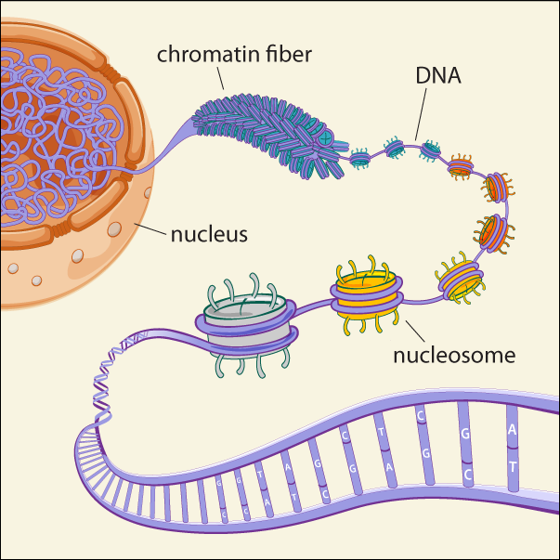
Long-term epigenetic reprogramming in myeloid cells
RNA-seq
Gene expression
Non-coding regulatory RNAs
AAAA
AAAA
AAAA
ATAC-seq
Open chromatin (i.e. nucleosome-free regions) can be bound by TFs, which can be identified by motif sequence
ChIP-seq
Histone tail modifications determine ‘activity’ by attracting TFs
(we use 5 histone modifications)
CH3
WGBS – whole genome bisulfite sequencing
DNA methylation maintains DNA in a closed state
CH3

Slide 11
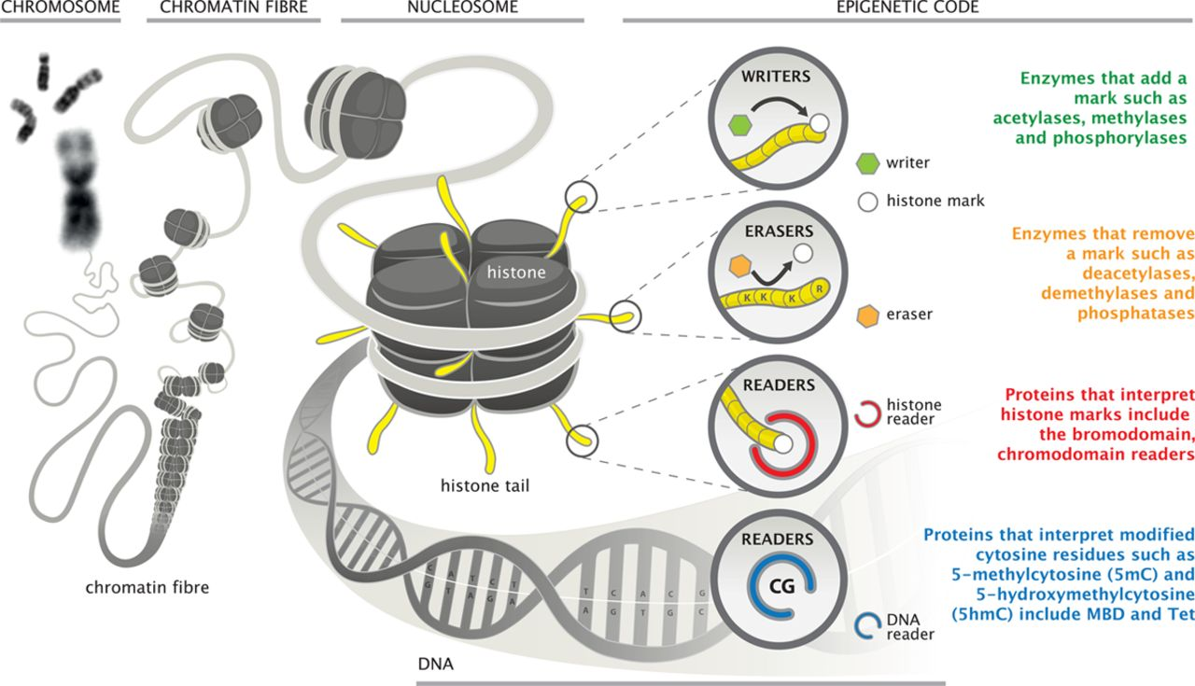
Long-term epigenetic reprogramming in myeloid cells
Epigenetics
A mechanism for turning genes ‘on’ or ‘off’ independent of DNA sequence
Keating S. and El-Osta S. 2015 Circ Res

Slide 12
Toward and advanced mechanistic model of trained immunity
Mhlanga et al., Nature Genetics, 2018

Slide 13
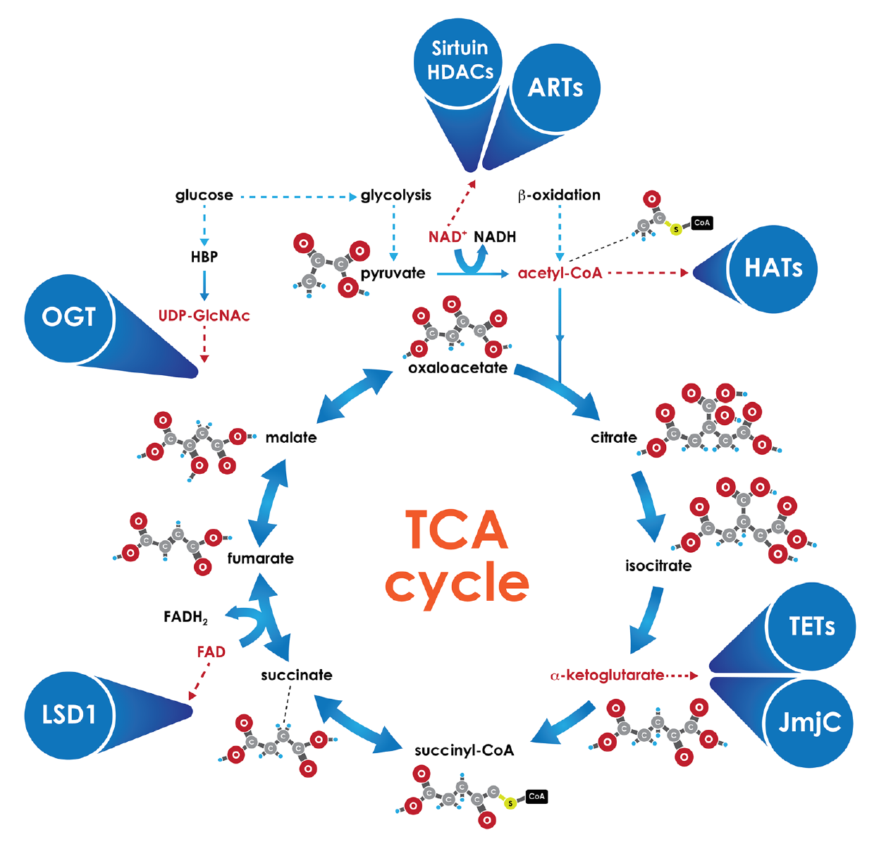
Metabolites are co-factors for epigenetic enzymes
Keating S., et al., 2016 Circ Res

Slide 14
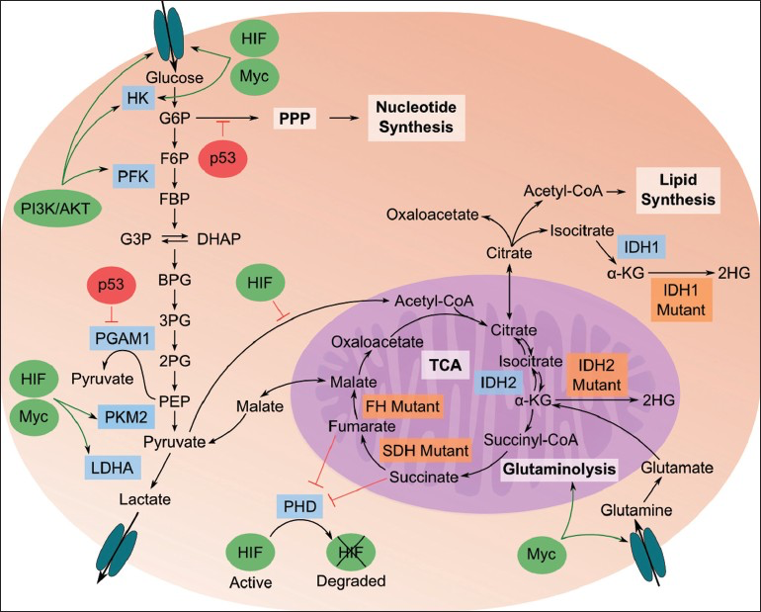
Metabolic pathways in myeloid cells

Slide 15
Metabolism in immune cells
TLR stimulation
glucose
glucose
autophagy
glucose
HIF-1α
mTOR
Akt
glycolysis
PDH
Oxidative phosphorylation
2ATP
pyruvate
Lipid synthesis
O₂ present
ACC
O₂ not present
AcetylCoA
NAD⁺
Krebs cycle
HIF-1α
Lactic acid
Electron transport
Histone acetyl transferase
36 ATP
NADH
Active cells
Naïve cells

Slide 16
What are the molecular pathways inTrained Immunity?
Chip-sequence analysis of all epigenetic modifications
Saeed, Quintin et al, Science, 2014

Slide 17
What are the molecular pathways of Training Immunity?
signaling
Saeed, Quintin et al, Science, 2014

Slide 18
What are the molecular pathways Trained Immunity ?
Metabolism
Saeed, Quintin et al, Science, 2014

Slide 19
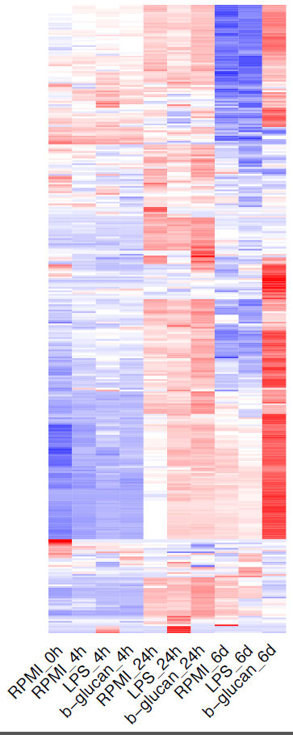
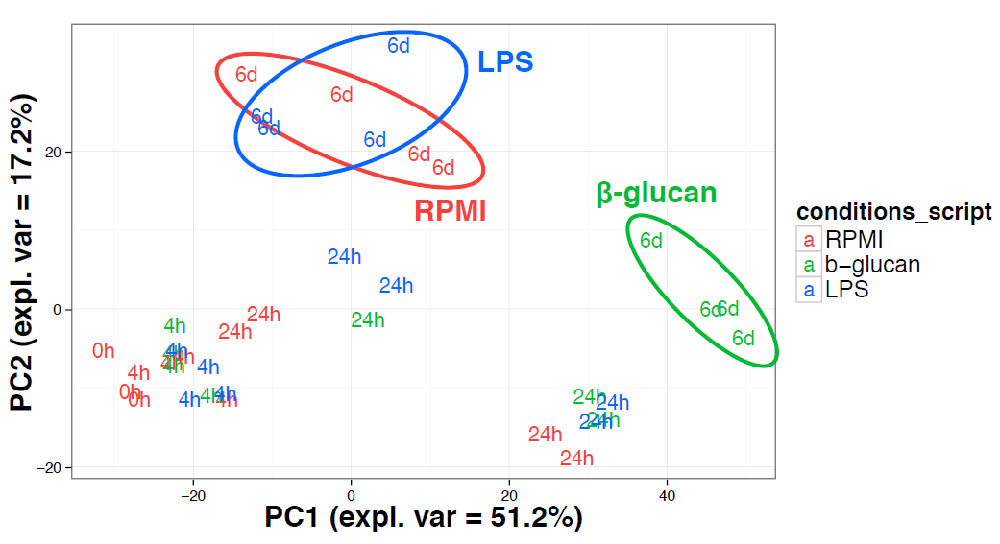
Metabolic status in trained monocytes
Metabolome analysis to identify metabolic pathways in trained monocytes
Arts et al, Cell Metabolism 2016;24(6):807-819.

Slide 20
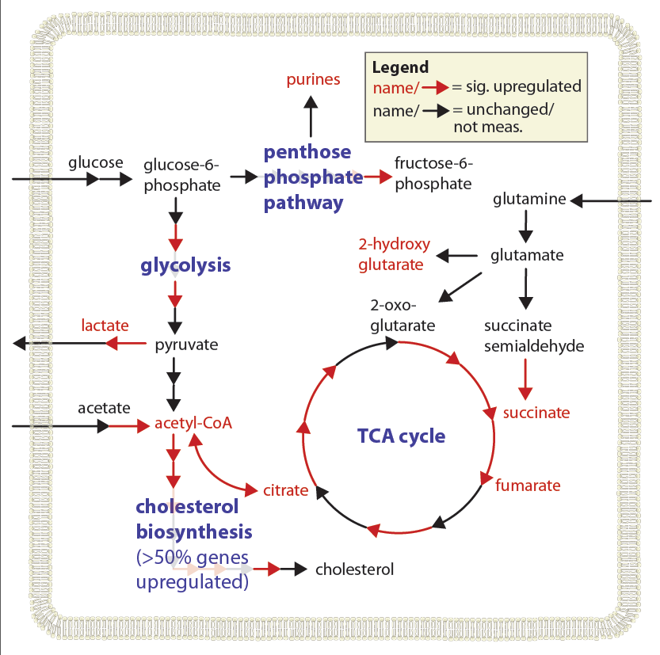
Metabolic status in Trained monocytes
Using bioinformatics and RNAseq and metabolome data sets pathways can be identified
Arts et al, Cell Metabolism 2016;24(6):807-819.

Slide 21
Metabolic status in trained monocytes
Arts et al, Cell Metabolism 2016;24(6):807-819.

Slide 22
Metabolic status in trained monocytes
Arts et al, Cell Metabolism 2016;24(6):807-819.

Slide 23
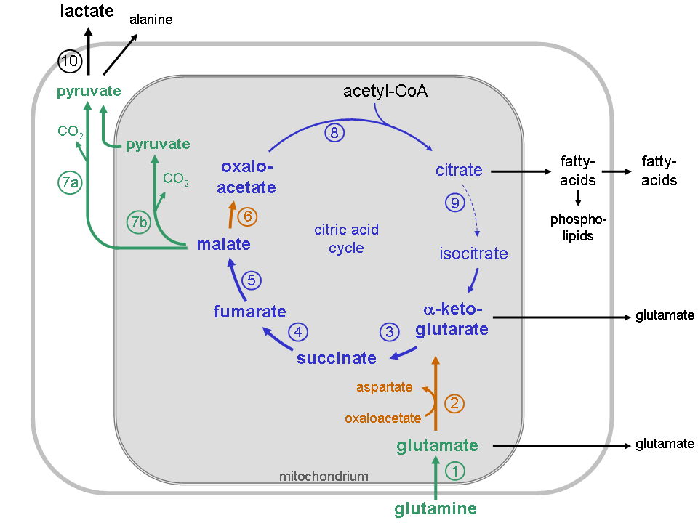
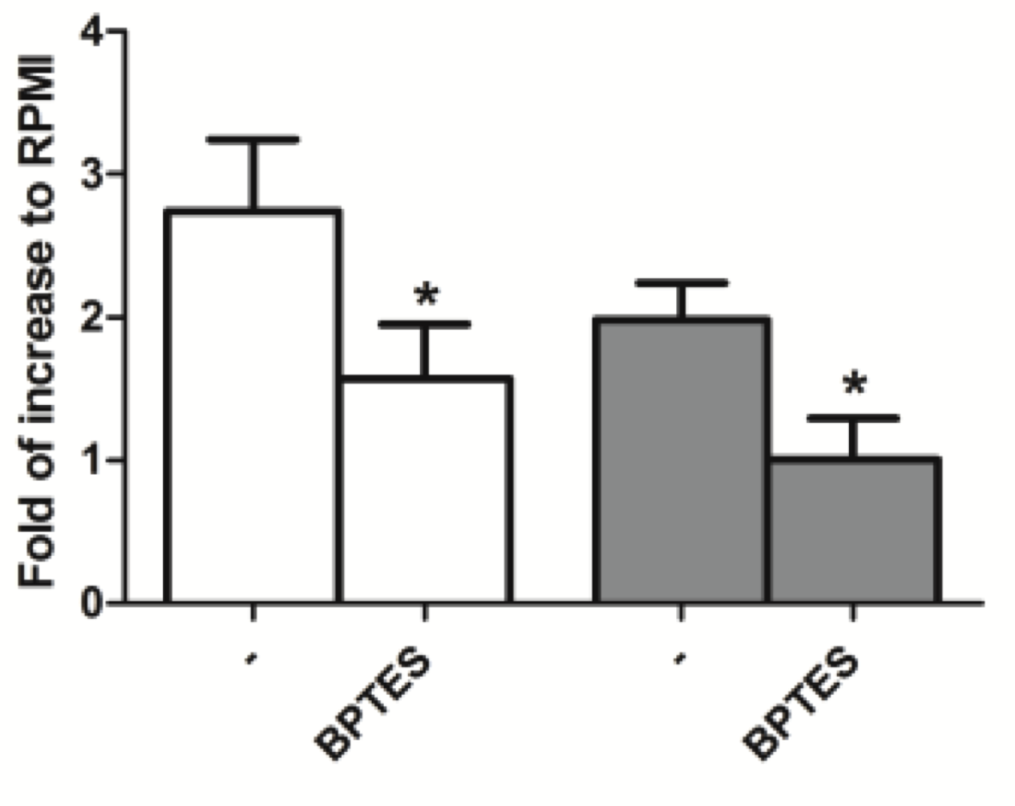
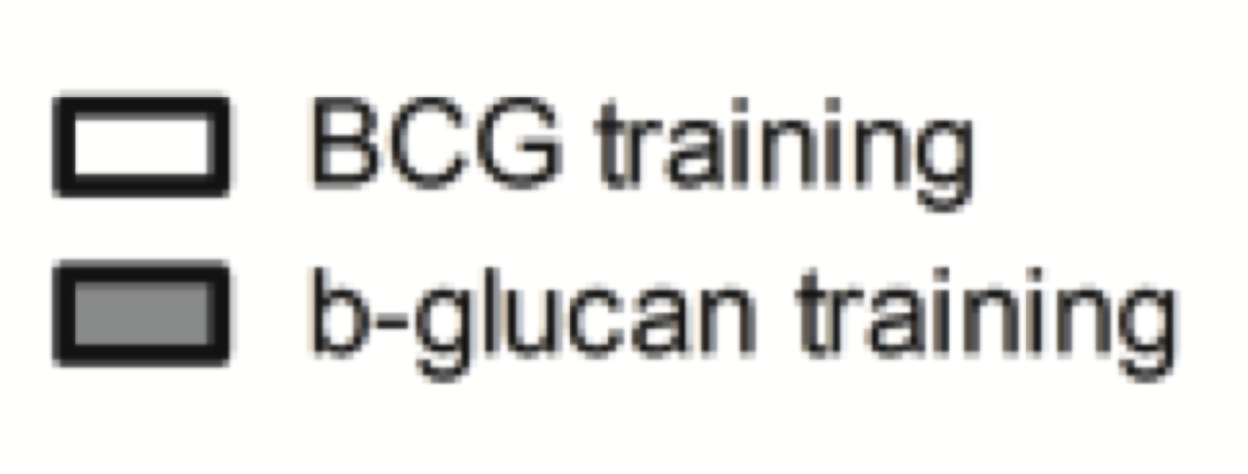
Glutamine metabolism in Trained monocytes
TNF
IL-6
BPTES inhibits glutaminase (1)
Arts et al, Cell Metabolism 2016 Dec 13;24(6):807-819.

Slide 24
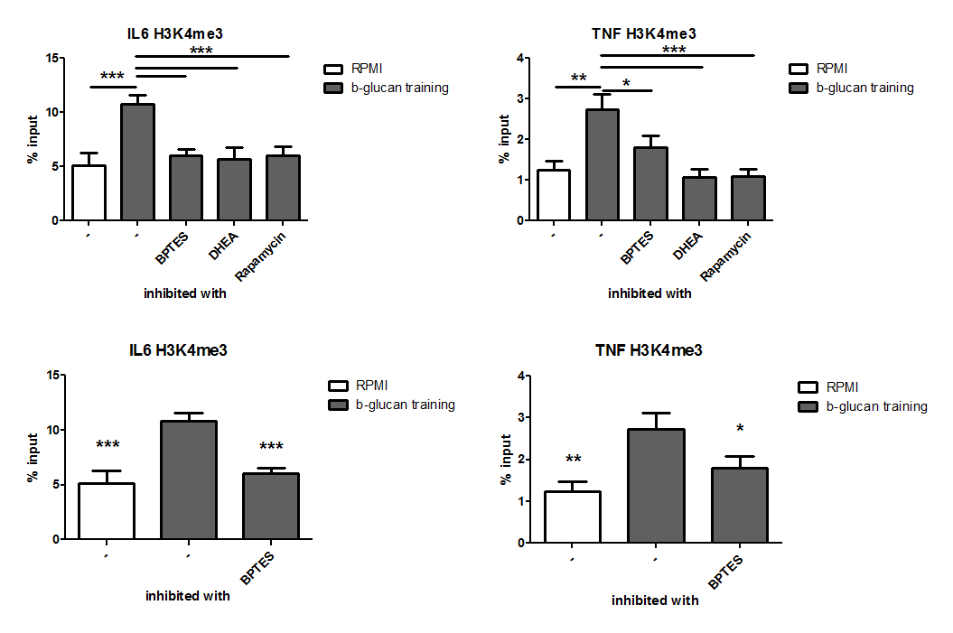
Glutamate induces Trained Immunity
Inhibition leads to suppression of histone modifications
Arts et al, Cell Metabolism 2016 Dec 13;24(6):807-819.

Slide 25

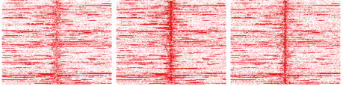
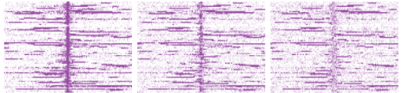
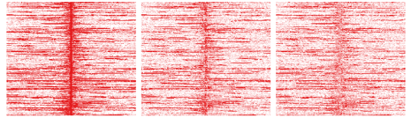
Fumarate induces Trained Immunity
Monocytes
Macrophages
RPMI
RPMI-Mf
Fumarate
Fuma-Mf
ChIP-seq (H3K4me3/H3K27ac)
BG
BG-Mf
24h
5 days
H3K4me3 read intensities
H3K27ac read intensities
39
peaks
Fumarate
up
Fumarate
up
139
peaks
85
peaks
Fumarate
down
Fumarate
down
193
peaks
BG_d6
Fumarate_d6
RPMI_d6
RPMI_d6
BG_d6
Fumarate_d6
Fumarate Up
Fumarate Up
DAVID GO biological process and KEGG pathways | P.adj
positive regulation of immune system process | 5.70E-03
regulation of T-helper 1 type immune response | 1.10E-02
positive regulation of leukocyte activation | 1.20E-02
GREAT pathway | P.adj
leukocyte migration | 1.55E-02
regulation of intracellular protein kinase cascade | 1.47E-02
cellular response to abiotic stimulus | 4.42E-02
Chip-sequence analysis of all epigenetic modifications
Arts et al, Cell Metabolism 2016 Dec 13;24(6):807-819.

Slide 26
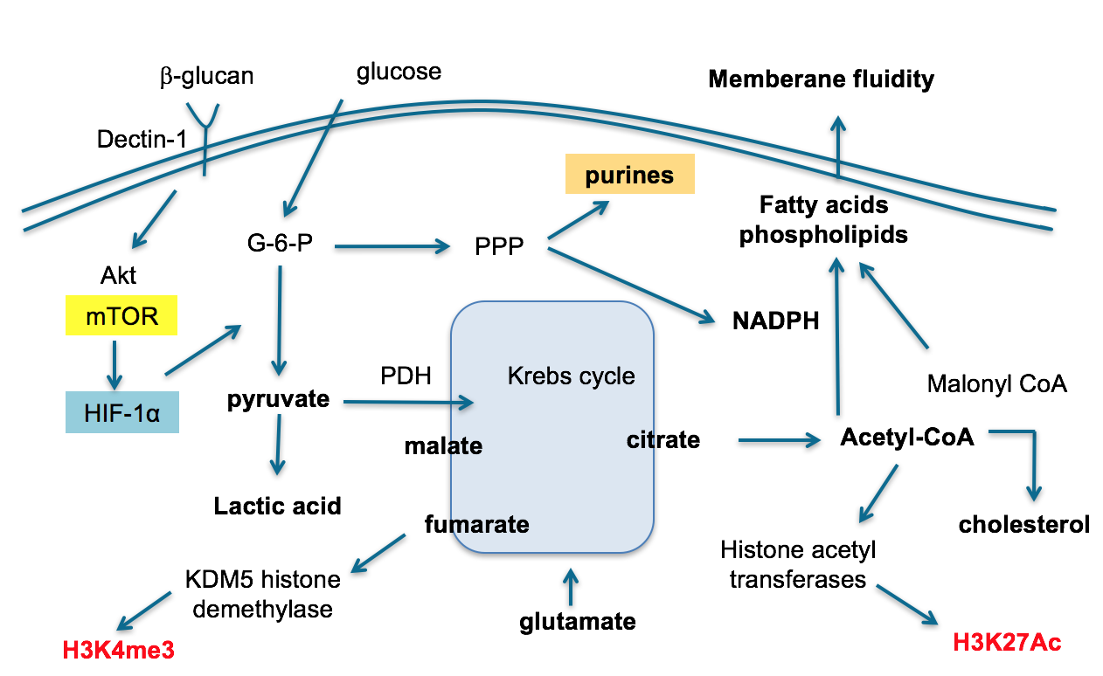
Metabolic reprogramming in trained monocytes
Arts RJW, et al. Cell Metab. 2016;24:807-19

Slide 27
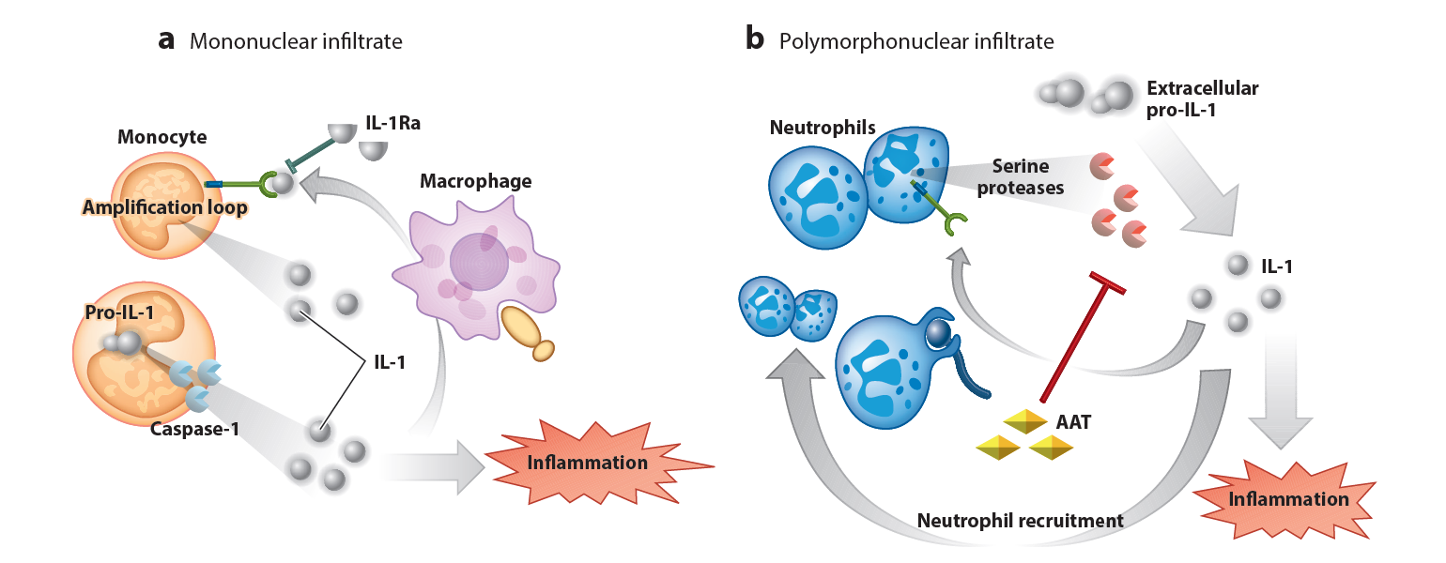
Hyperuricemia
Hyperuricemia, MSU crystallization, Gout and IL-1β.
Normal serum uric acid levels ~2-6 mg/dl
Hyperuricaemia >6.8 mg/dl
MSU crystals
Mechanisms of acute Gout attacks
IL-1β
IL-1β
Joosten LA, Arthritis & Rheumatology 2010;62:3237-48.
Netea MG, Annu Rev Immunol 2015;33:49-77.
Joosten LA, Ann Rheum Dis, 2016; 75(6):1219-27

Slide 28
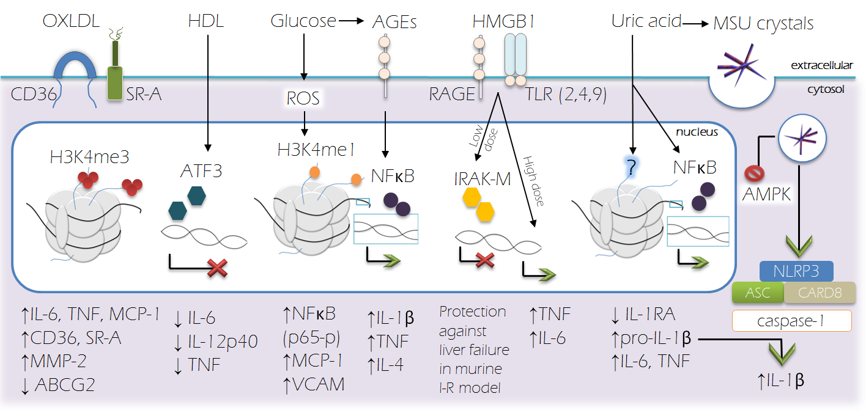
Hyperuricemia
Hyperuricemia and metabolic and epigenetic reprogramming of innate immune cells
Crisan TO, et al. Eur J Immunol. 2016;46:817-28.

Slide 29
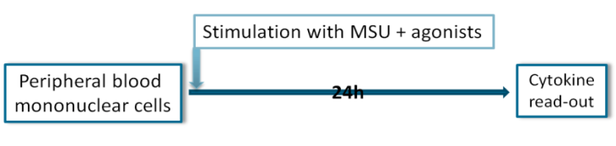

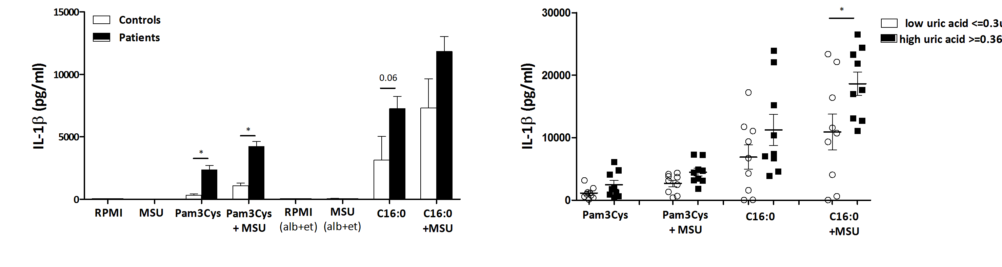
Hyperuricemia
Enhanced ex-vivo cytokine production in gout patients
compared to healthy controls
Cytokine production is related to urate levels!
Crisan TO, et al., Ann Rheum Dis, 2016
Notes:
Subject of study on this project, sources of differences patients vs. controls, hyperuricaemia correlates with increased cytokine responses

Slide 30
Cytokine responses in relation to serum Urate
500 FG project
Healthy subjects
Kluck V, Cleophas MC, Crisan TO, et al. Submitted

Slide 31
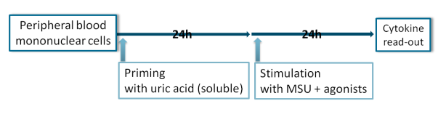

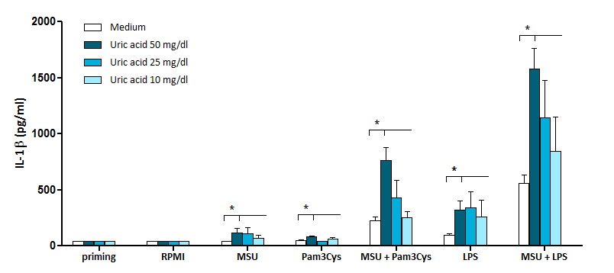
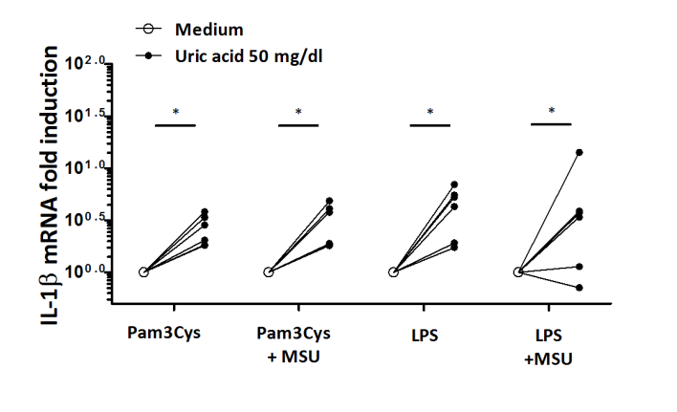
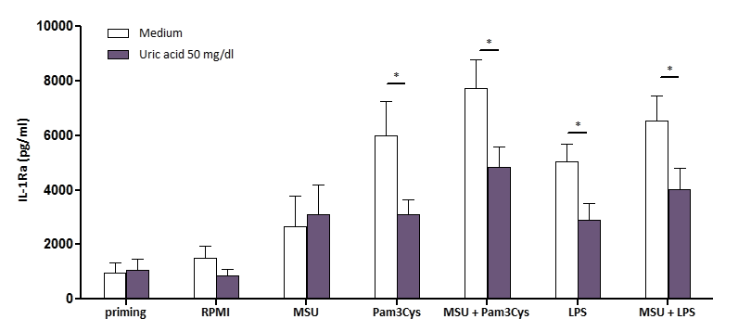
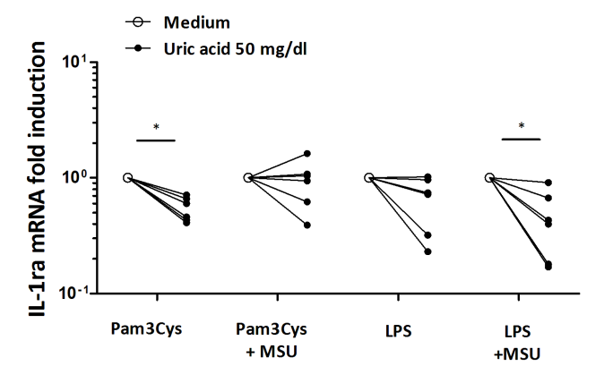
Hyperuricemia
In vitro induction “trained immunity” by soluble uric acid
4h
qPCR
Crisan TO, et al., Ann Rheum Dis, 2016;75:755-62
Notes:
In vitro – high dose uric acid increases IL-1 transcription+protein (as well as IL-6,TNF, IL-1alpha) while reducing IL-1Ra (mRNA+protein)

Slide 32
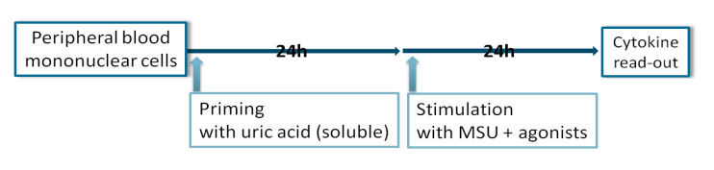
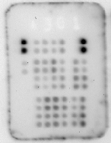
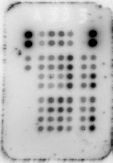
Hyperuricemia
Uric acid activates the mTOR/Akt/PRAS 40 pathway
Monocytes
24h
8min
Kinase array
Uric acid priming
LPS stimulation
Uric acid
Kinase | Site | %change
Fyn | Y420 | -77
HcK | Y411 | -76
p27 | T198 | -73
GSK-3 alpha/beta | S21/S9 | 42
ERK 1/2 | T202/Y204, T185/Y187 | 54
PRAS40 | T246 | 72
Akt-P
PRAS 40-P :
dissociation from mTORC1
Reduced
ROS
mTOR
Inhibition of autophagy
No priming Uric acid
↑IL-1β
↓IL-1ra
IL-1RI
+
+++
+
IL-1ra
↓ ↓
↑IL-1β
↓IL-1ra
IL-1β
Crisan TO, et al., PNAS 2017
Notes:
PRAS40 phosphorylation increased after uric acid in 3 donors using RnD kinase profiler (LPS or SCW stimulation). PRAS40 is phosphorylated by Akt which allows it to dissociate from Raptor (mTORC1) and remove its repressive effect on mTOR complex1. mTOR induction has multiple effects but the most likely to explain the distinctive cytokine pattern seen with uric acid is autophagy inhibition.

Slide 33
Hyperuricemia
Model of metabolic activation of monocytes by urate
Uric acid
β-glucan
glucose
dectin-1
glucose
PRAS40
HIF-1α
mTOR
Akt
Increased
glycolysis
PRAS40
PDH
Uric acid
pyruvate
Low
TCA cycle
Low oxidative phosphorylation
High
Lactic acid
Metabolites change the phenotype of monocytes, why ?
Cheng et al, Science, 2014

Slide 34
Hyperuricemia
Metabolic reprogramming in Urate trained monocytes ?
Uric acid
Uric acid ?
PRAS40
α-keto-glutarate
TETs
Arts RJW, et al. Cell Metab. 2016;24:807-19
Crisan TO, et al. 2018 submitted.

Slide 35

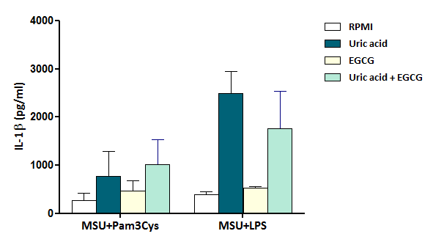
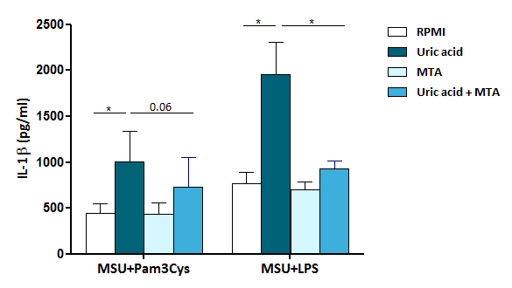
Hyperuricemia
Effects of acetylation and methylation inhibition on
urate-induced enhanced cytokine production
+/-
Acetyl-transferase inhibitor
(EGCG=epigallocatechin gallate)
+/-
Methyl-transferase inhibitor
(MTA=methylthioadenosine)
Crisan TO, et al., Ann Rheum Dis, 2016

Slide 36
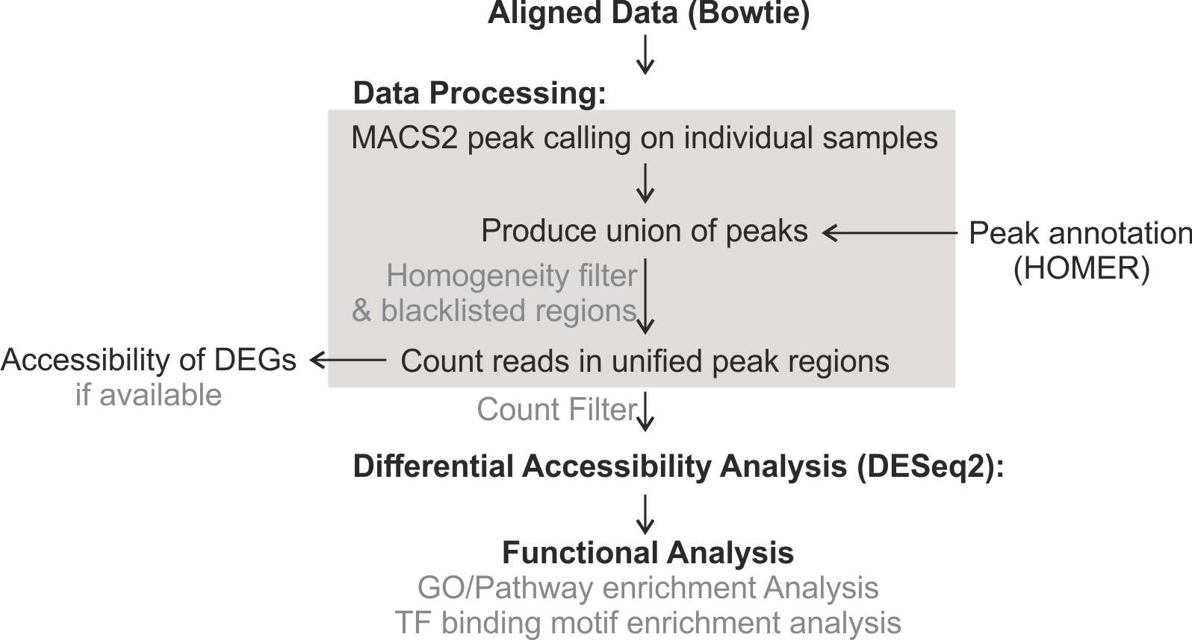
Hyperuricemia
ATACseq and RNAseq analysis of urate exposed monocytes (Bonn University-LIMES)
Human primary monocytes cultured for 24h in 10% serum (n=6 donors)
Human primary monocytes cultured for 24h in 10% serum + 0.5 mg/ml Urate (n=6 donors)
RNA sequence and ATAC sequence was performed in the same donors
Analysis Approach

Slide 37
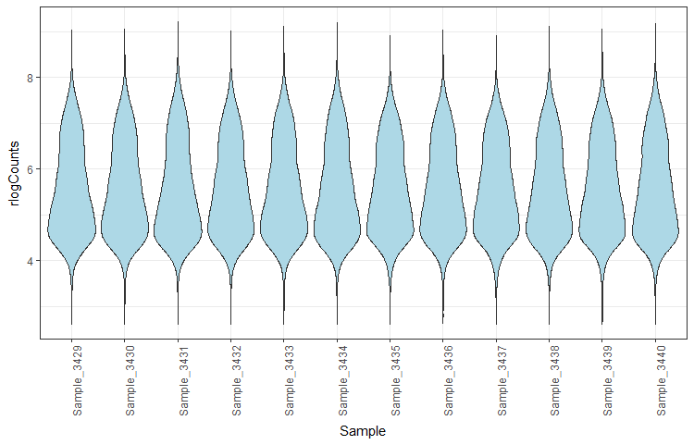
DESeq2 results – rlog normalization
Hyperuricemia
Minimum Homogeneity=4, filtered for cpm>10 in at least one sample -> 31612 peaks
rlogCounts <- rlog(atacData, blind = TRUE, fitType = "local")
Notes:
### The rlog and variance stabilizing transformations
# Many common statistical methods for exploratory analysis of multidimensional data, for example clustering and principal
# components analysis (PCA), work best for data that generally has the same range of variance at different ranges of the
# mean values. When the expected amount of variance is approximately the same across different mean values, the data is said
# to be homoskedastic. For RNA-seq counts, however, the expected variance grows with the mean. For example, if one performs
# PCA directly on a matrix of counts or normalized counts (e.g. correcting for differences in sequencing depth), the resulting
# plot typically depends mostly on the genes with highest counts because they show the largest absolute differences between
# samples. A simple and often used strategy to avoid this is to take the logarithm of the normalized count values plus a
# pseudocount of 1; however, depending on the choice of pseudocount, now the genes with the very lowest counts will contribute
# a great deal of noise to the resulting plot, because taking the logarithm of small counts actually inflates their variance.
#
# As a solution, DESeq2 offers two transformations for count data that stabilize the variance across the mean: the
# regularized-logarithm transformation or rlog (Love, Huber, and Anders 2014), and the variance stabilizing transformation (VST)
# for negative binomial data with a dispersion-mean trend (Anders and Huber 2010), implemented in the vst function.
# For genes with high counts, the rlog and VST will give similar result to the ordinary log2 transformation of normalized counts.
# For genes with lower counts, however, the values are shrunken towards the genes' averages across all samples.
# The rlog-transformed or VST data then becomes approximately homoskedastic, and can be used directly for computing
# distances between samples, making PCA plots, or as input to downstream methods which perform best with homoskedastic data.

Slide 38
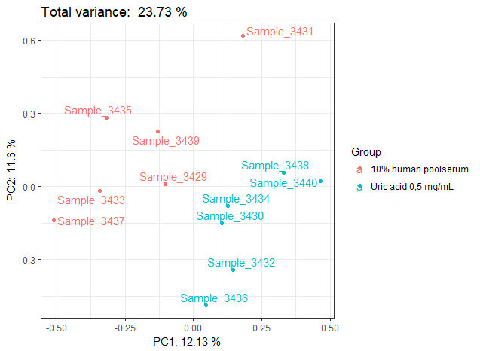
DESeq2 results – rlog normalization
Hyperuricemia
Minimum Homogeneity=4,
filtered for cpm>10 in at least one sample -> 31612 peaks
DA regons (DESeq2):
After batch correction, samples cluster according to the stimulation.

Slide 39
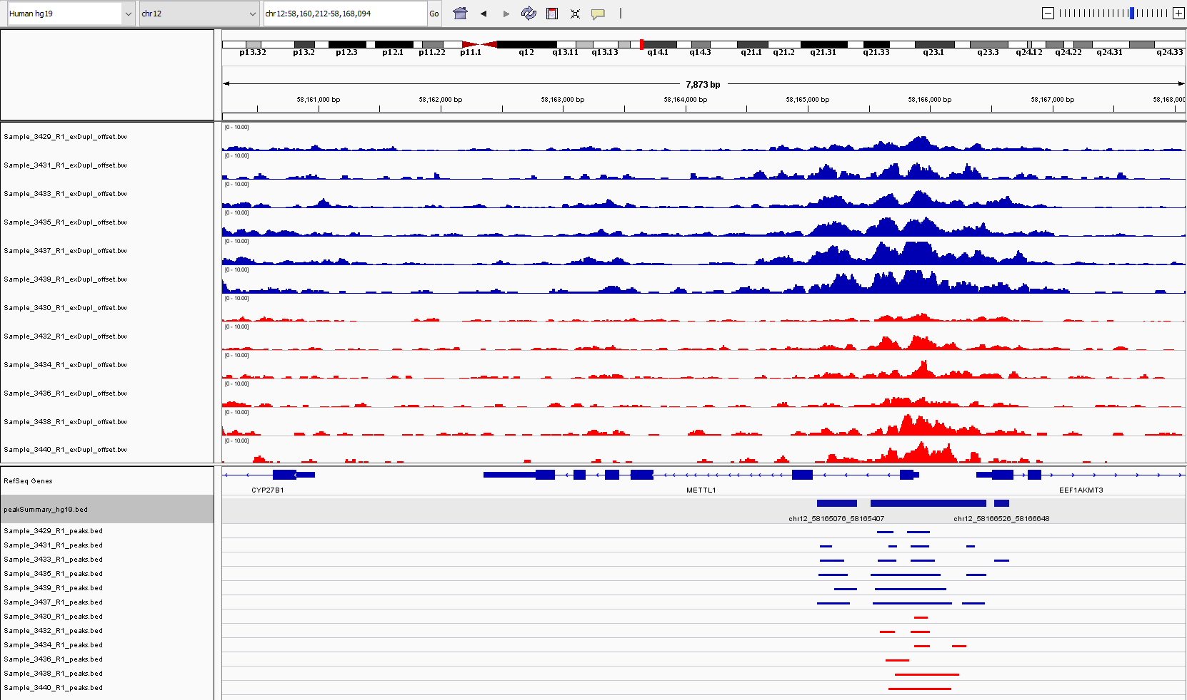
Exemplary Locus: chr12: 58165076-58165407 (METTL1)
Hyperuricemia
Control
Urate

Slide 40
METTL1 expression in cells/tissues
Hyperuricemia
CD34+ cells (Myeloid cells)

Slide 41
Hyperuricemia
METTL1 = tRNA (guanine-N(7)-)-methyltransferase
METTL1
Stojković V. et al. Curr Opin Chem Biol. 2017 Dec;41:20-27.

Slide 42
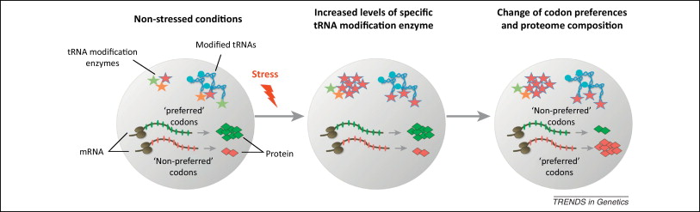
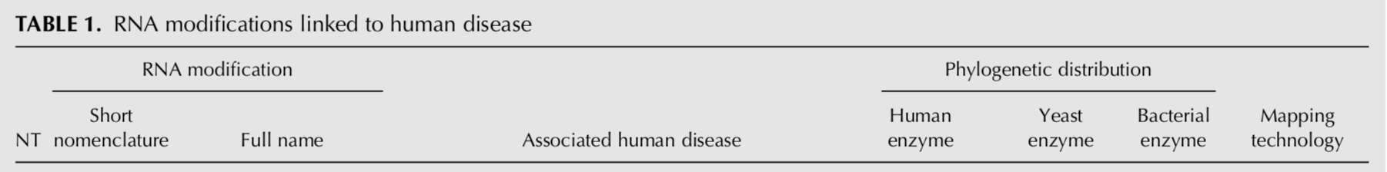

Hyperuricemia
METTL1 = tRNA (guanine-N(7)-)-methyltransferase
Jonkhout N, et al. The RNA modification landscape in human disease. RNA. 2017 Dec;23(12):1754-1769.

Slide 43
Urate exposure results in reprograming of innate immune cells
PRAS40-mTOR pathway activated (Tania Crisan et al. PNAS, 2017)
Transcriptome different after urate exposure
ATAC sequence revealed several different suppressed genes
METTL1 identified as novel target in urate exposed cells

Slide 44
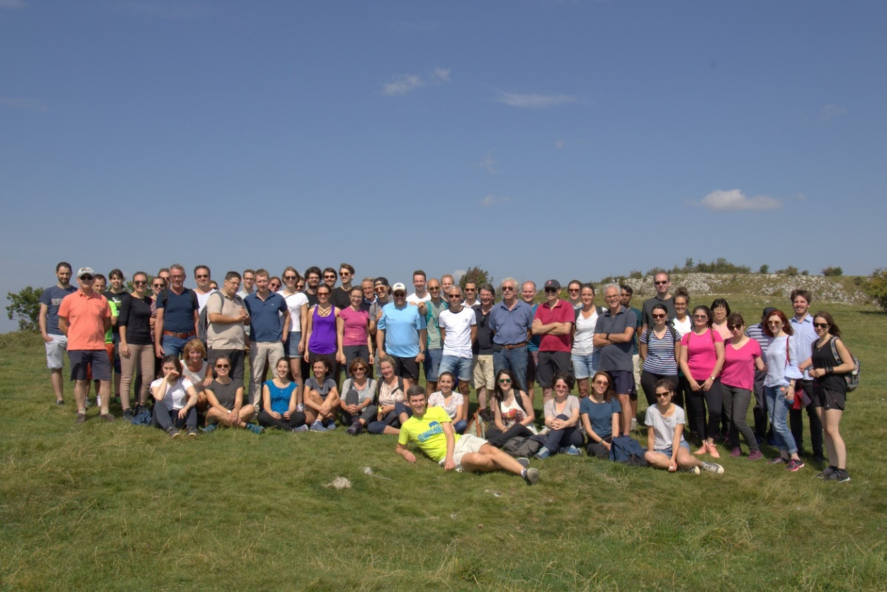
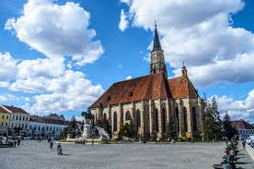
Thank you !
Depart. of Internal Medicine
Tania Crisan
Maartje Cleophas
Viola Kluck
Rob ter Horst
Charles A. Dinarello
Jos W.M. van der Meer
Mihai G. Netea
Dept. Molecular Biology
Boris Novakovic
Henk Stunnenberg
University of Medicine and Pharmacy „Iuliu Hațieganu”
Tania Crisan
Radu Popp
Marius Farcas
Medeea Badii
Ildiko Gaal
Dragos Marginean
Loredana Peca
Ioana Hotea
Cristina Pamfil
Simona Rednic
Bonn University - LIMES
Jonas Schulte-Schrepping
Thomas Ulas
Joachim Schultze

